Slide 1


Slide 2

Tutorial 14 Sections 009/010
TA: Greydon Gilmore
Physiology 2130
Jan 21st, 2020

Slide 3

Your TA reminding you…
3rd Peerwise assignment (1.5%)
Post 2 MC questions: due Feb 12th @ midnight
Answer 5 MC questions: due Feb 14th @ midnight
3rd Quiz (1%)
Opens: Feb 24th @ 4pm
Closes: Feb 25th @ 4pm
3rd Midterm (15%)
When: Feb 28th @ 6pm-7pm

Slide 4

Midterm #2 Results
17 students with 100%

Slide 5
Today
Group work activities
Learning Catalytics Question
Renal Physiology

Slide 6
Group Work

Slide 7
Sandra has been referred to a nephrology clinic due to the pain she has been experiencing in her lower back, which may be related to a problem with her kidneys. The following is her blood work and urinalysis results:
[Sodium]plasma = 8 mg/L
[Potassium]plasma = 2 mg/L
[Creatinine]plasma = 2 mg/L
[Glucose]plasma = 15 mg/L
[Magnesium]plasma = 20 mg/L
[Sodium]urine = 10 mg/L
[Potassium]urine = 12 mg/L
[Creatinine]urine = 120 mg/L
[Glucose]urine = 0 mg/L
[Magnesium]urine = 15 mg/L
Urine volume = 2.5 L/day
Calculate Sandra’s GFR.
What is the filtered load of sodium?
What is the filtered load of glucose?
What is the filtered load of magnesium?
What is the renal handling for potassium?

Slide 8
Calculate the net filtration pressure if the forces are determined as the following:
Hydrostatic pressure of Bowman’s capsule = 35 mmHg
Hydrostatic pressure of Glomerular capillaries = 60 mmHg
Colloid osmotic pressure of Bowman’s capsule = 5 mmHg
Colloid osmotic pressure of Glomerular capillaries = 25 mmHg
Based on the calculation you have made, knowing that normal net filtration pressure is 10
mmHg, is this person filtering a normal volume, less or more volume of fluid per day?

Slide 9
Think of and discuss analogies that could help to understand renal physiology.
ie. symporters are like Ferris wheels when the passengers get on, the Ferris wheel turns.
post the analogy to Learning catalytics

Slide 10
Learning Catalytic Question

Slide 11
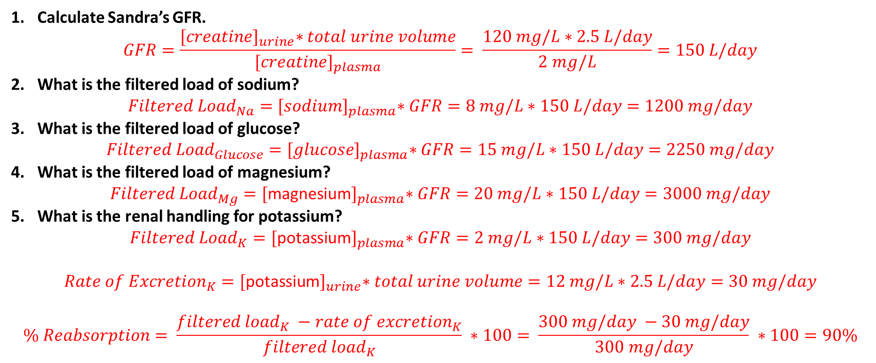
Sandra has been referred to a nephrology clinic due to the pain she has been experiencing in her lower back, which may be related to a problem with her kidneys. The following is her blood work and urinalysis results (Page 259):
Calculate Sandra’s GFR.
$$GFR=\frac{{[creatine]}_{urine}∗total urine volume}{{[creatine]}_{plasma}}= \frac{120 mg/L∗2.5 L/day}{2 mg/L}=150 L/day$$
What is the filtered load of sodium?
$${Filtered Load}_{Na}={[sodium]}_{plasma}∗GFR=8 mg/L∗150 L/day=1200 mg/day$$
What is the filtered load of glucose?
$${Filtered Load}_{Glucose}={[glucose]}_{plasma}∗GFR=15 mg/L∗150 L/day=2250 mg/day$$
What is the filtered load of magnesium?
$${Filtered Load}_{Mg}={[\text{magnesium}]}_{plasma}∗GFR=20 mg/L∗150 L/day=3000 mg/day$$
What is the renal handling for potassium?
$${Filtered Load}_{K}={[\text{potassium}]}_{plasma}∗GFR=2 mg/L∗150 L/day=300 mg/day$$
$${Rate of Excretion}_{K}={[\text{potassium}]}_{urine}∗total urine volume=12 mg/L∗2.5 L/day=30 mg/day$$
$$\% Reabsorption= \frac{{filtered load}_{K} −{rate of excretion}_{K}}{{filtered load}_{K}} ∗100= \frac{300 mg/day −30 mg/day}{300 mg/day} ∗100=90\%$$

Slide 12
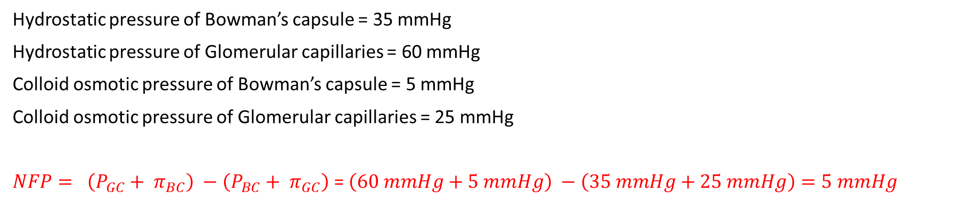
Calculate the net filtration pressure if the forces are determined as the following:
Hydrostatic pressure of Bowman’s capsule = 35 mmHg
Hydrostatic pressure of Glomerular capillaries = 60 mmHg
Colloid osmotic pressure of Bowman’s capsule = 5 mmHg
Colloid osmotic pressure of Glomerular capillaries = 25 mmHg
$NFP= \left(P_{GC}+ π_{BC}\right) −\left(P_{BC}+ π_{GC}\right)$ = $\left(60 mmHg+5 mmHg\right) −\left(35 mmHg+25 mmHg\right)=5 mmHg$
Based on the calculation you have made, knowing that normal net filtration pressure is 10
mmHg, is this person filtering a normal volume, less or more volume of fluid per day?
Since it is less than normal, this person would filter less fluid per day than a healthy individual.

Slide 13
Renal Physiology
Chapter 8: Dr. Woods

Slide 14
An individual suffers from kidney failure, which leads to development of a disease. Their symptoms are likely linked to …
Build up of waste
Inability to produce new glucose
Inability to produce hormones
Severe ion imbalance

Slide 15
An individual suffers from kidney failure, which leads to development of a disease. Their symptoms are likely linked to …
Build up of waste
Inability to produce new glucose
Inability to produce hormones
Severe ion imbalance

Slide 16
Kidney Functions
The kidneys most important role is to regulate salt and water balance, not to remove waste
Regulation of ECF volume and blood pressure
Regulation of osmolarity
Maintain ion balance
Maintenance of body pH
Excretion of wastes
Production of hormones
Gluconeogenesis

Slide 17
Kidney Anatomy
Two kidneys that sit posterior and outside of abdominal cavity (i.e. retroperitoneal)
Cortex = outer portion
Medulla = inner portion
Fluid collected into minor calyces → major calyces → renal pelvis → ureter
Renal artery carries blood to kidneys
Renal vein carries blood away from kidneys

Slide 18
Nephron
Functional unit of kidney
~1 million per kidney
Two major components:
Renal corpuscle:
Contains glomerulus and Bowman’s capsule
Where filtration occurs
Tubule
Proximal tubule → descending limb of loop of Henle → ascending limb of loop of Henle → distal convoluted tubule
Where reabsorption and secretion occur

Slide 19
Nephron Organization In The Kidney
Renal corpuscle located in cortex
Loop of Henle projects into and out of renal medulla
4-5 nephrons share a collecting duct
Collecting ducts drain into minor calyx
In 3D, the ascending limb is found near the glomerulus

Slide 20
Types of Nephrons
 | Juxamedullary Nephron | Cortical Nephron
# in Kidney | Few | Many
Ability to concentrate urine | Good | Bad
Ability to filter blood | Good | Good
Location of Corpuscle in Cortex | Low | High
Loop of Henle | Long | Short
Capillaries | Vasa recta | Peritubular

Slide 21
If blood is detected in a patient’s urine, you can conclude that:
There is damage to the glomerulus that lead to abnormal filtration
There is damage to the glomerulus that lead to abnormal reabsorption
There is damage to the collecting duct that lead to abnormal reabsorption
There is damage to the colleting duct that lead to abnormal secretion

Slide 22
If blood is detected in a patient’s urine, you can conclude that:
There is damage to the glomerulus that lead to abnormal filtration
There is damage to the glomerulus that lead to abnormal reabsorption
There is damage to the collecting duct that lead to abnormal reabsorption
There is damage to the colleting duct that lead to abnormal secretion

Slide 23
Renal Corpuscle
Glomerulus: Group of fenestrated capillaries
Fenestrations allow passage of many substances (ions, water, etc.) into Bowman’s space (except red/white blood cells)
Cells of Bowman’s capsule (outer layer) are simple squamous epithelial cells
Cells of Bowman’s capsule (inner layer) are called podocytes
Cells of glomerular capillaries are called endothelial cells
Endothelial cells are fused with podocytes by basal lamina

Slide 24
Barriers to Filtration
Size of glomerular gaps/fenestrations
Gaps in basal lamina
Space between podocytes

Slide 25
Juxtaglomerular Apparatus (JGA)
Structure formed by late ascending loop of Henle passing between afferent and efferent arteriole near renal corpuscle
Specialized cells of ascending limb called macula densa cells
Detect [Na⁺] and [Cl⁻] in filtrate
Specialized cells on arteriole called granular cells
Produce renin

Slide 26
Blood Flow In Kidneys
Receives 20% of cardiac output

Slide 27
3 Key Processes
 | Filtration | Reabsorption | Secretion
Where does it occur? | Renal Corpuscle | Tubule | Tubule
From _____ to _____. | From glomerular capillaries to Bowman’s space | From lumen of tubule to surrounding capillaries (peritubular/ vasa recta) | From surrounding capillaries (peritubular/vasa recta) to lumen of tubule
Overall | Blood → Pre-urine (filtrate) | Removes from filtrate (e.g. body wants to keep) | Adds to filtrate (e.g. body wants to remove as waste)

Slide 28
Glomerular Filtration
Of all the blood that arrives at kidney, only 20% is filtered
Net filtration pressure (NFP): Sum of forces that affect filtration
NFP > 0: filtration
NFP ≤ 0: no filtration
 | Hydrostatic Pressure of Glomerular Capillaries | Colloid Osmotic Pressure of Glomerular Capillaries | Hydrostatic Pressure of Bowman’s Capsule | Colloid Osmotic Pressure of Bowman’s Capsule
Abbreviation | P_{GC} | π_{GC} | P_{BC} | π_{BC}
Caused by | Blood flowing into glomerulus | Presence of proteins in glomerulus | Filtrate remaining in Bowman’s space | Presence of proteins in Bowman’s space
Filtration | Promotes | Inhibits | Inhibits | Promotes
mmHg | 55 | 30 | 15 | 0

Slide 29
NFP Calculation
NFP = Promotes Filtration – Inhibits Filtration
= (P_{GC}+ π_{BC}) – (P_{BC}+ π_{GC})
= (55 + 0) – (15 + 30)
= 10 mmHg
 | P_{GC} | π_{GC} | P_{BC} | π_{BC}
Filtration | Promotes | Inhibits | Inhibits | Promotes
mmHg | 55 | 30 | 15 | 0

Slide 30
Will filtration occur if: P_{GC} = 20 mmHg, P_{BC} = 20 mmHg, π_{GC} = 15 mmHg, π_{BC} = 5 mmHg,
No, because NFP = -10 mmHg
Yes, because NFP = +10mmHg
No, because NFP = -20mmHg
Yes, because NFP = +20mmHg

Slide 31
Will filtration occur if: P_{GC} = 20 mmHg, P_{BC} = 20 mmHg, π_{GC} = 15 mmHg, π_{BC} = 5 mmHg,
No, because NFP = -10 mmHg
Yes, because NFP = +10mmHg
No, because NFP = -20mmHg
Yes, because NFP = +20mmHg
NFP = (P_{GC} + π_{BC} ) - (P_{BC} + π_{GC} )
= (20 + 5) - (20 + 15)
= -10 mmHg

Slide 32
Glomerular Filtration Rate (GFR)
Volume of fluid filtered per day by the kidneys
Normal: 180 L/day
Important to maintain a constant GFR throughout the day
Affected by:
Net Filtration Pressure (NFP)
Mostly affected by renal blood flow and pressure (P_{GC})
Filtration Coefficient
Mostly affected by podocytes and basal lamina

Slide 33
GFR Regulation: Myogenic Response
Arterial blood pressure
Afferent arteriolar blood pressure
Afferent arteriole stretches
Sensing by stretch sensitive ion channels (opening)
Depolarization of smooth muscle open voltage-gated Ca²⁺ channels
Smooth muscles of afferent arteriole contraction
Vasoconstriction
Blood flow in glomerulus

Slide 34
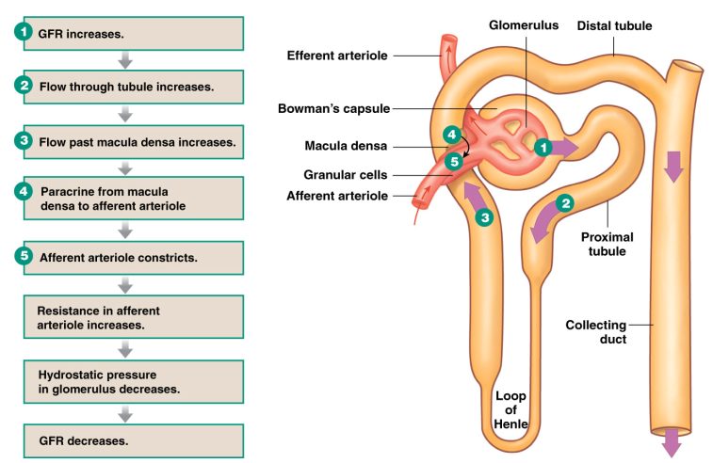
GFR Regulation: Tubuloglomerular feedback

Slide 35
GFR Regulation: Overview
Both the myogenic response and tubuloglomerular response are used to increase and decrease GFR
Their combined goal is to mediate a constant GFR throughout the day
 | Afferent Arteriole |  | Efferent Arteriole
Smooth Muscle | Dilate | Constrict | Dilate | Constrict
GFR

Slide 36
Measurement of GFR
In order to measure GFR, you want to choose a substance that is excreted, but not reabsorbed
Bad substances: glucose, ions, water
Best substance: creatinine
Rate of creatinine excretion from the body is equivalent to GFR
GFR (L/day) = ([Creatinine]_{urine} x Urine/day ) / [Creatinine]_{plasma}
= (90 mg/L x 2 L/day) / (1 mg/L)
= 180 L/day

Slide 37
Renal Handling
GFR can be used to calculate renal handling (i.e. what they kidney did to the substance from the plasma)
Filtered Load of X = [X]_{plasma} x GFR
Reminder: Normal GFR = 180 L/day or 125 mg/min
Can you fill out this table?
Substance | Concentration (in plasma) | Filtered Load | Amount Excreted | % Excreted | % Reabsorbed
Sodium | 3.5 g/L |  | 3.2 g
Glucose | 1.0 g/L |  | 0 g
Urea | 0.31 g/L |  | 28 g

Slide 38
Renal Handling
Example: Urea
Filtered Load of Urea = [Urea]_{plasma} x GFR = 0.31 x 180
= 56 g/day
% Excreted = (Amount Excreted/Filtered Load) x 100% = (28/56) x 100%
= 50 %
% Reabsorbed = 100 -% Excreted = 100 –50
= 50%
Substance | Concentration (in plasma) | Filtered Load | Amount Excreted | % Excreted | % Reabsorbed
Sodium | 3.5 g/L | 630 g/day | 3.2 g | 0.5% | 99.5%
Glucose | 1.0 g/L | 180 g/day | 0 g | 0% | 100%
Urea | 0.31 g/L | 56 g/day | 28 g | 50% | 50%

Slide 39
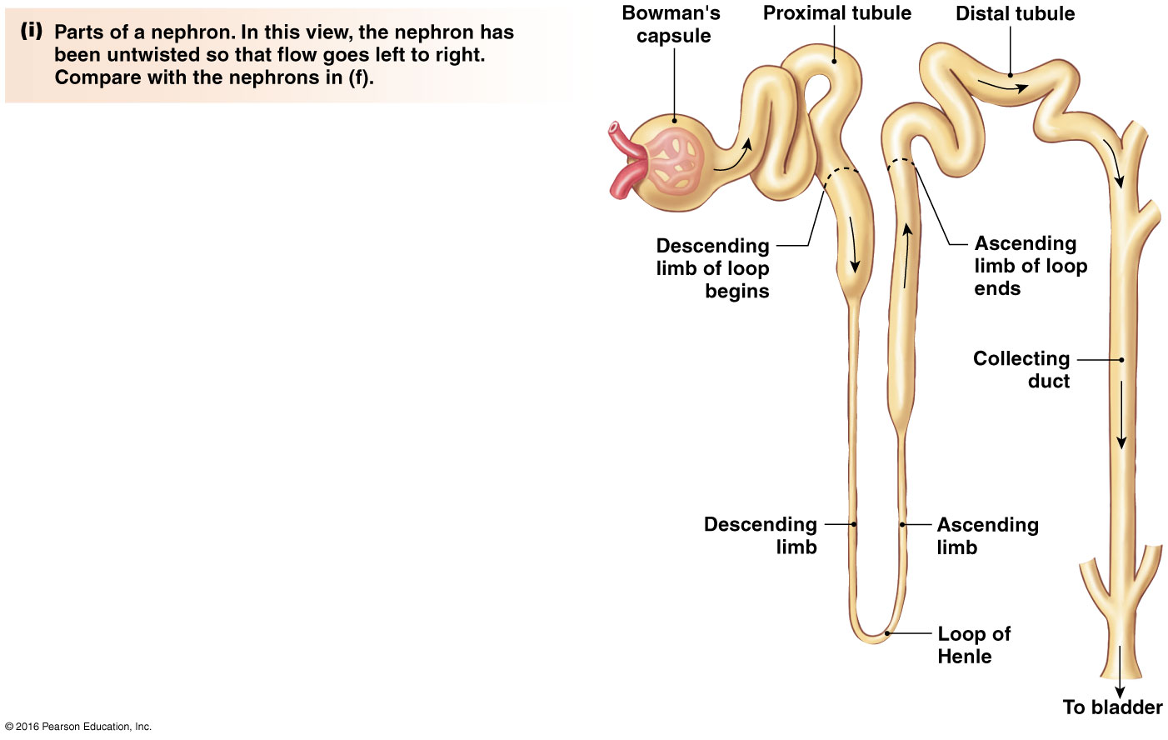
Reabsorption Along The Tubule
65% volume reabsorbed
Segment of Tubule | Substances | Hormone Regulation | Percent
Proximal Tubule | Glucose, amino acids, H₂O, Na⁺, K⁺, Cl⁻ | Yes | 65%
Descending Limb of LOH | H₂O, minimal Na⁺ | No | 20 %
Ascending Limb of LOH | Na⁺, K⁺, Cl⁻ | No
Distal Tubule | Na⁺, K⁺, Cl⁻ , Ca²⁺ | Yes | 14%
Collecting Duct | H₂O, Na⁺ | Yes
14% volume reabsorbed
20% volume reabsorbed

Slide 40
Cells of the Tubule

Slide 41
Cells of the Tubule
Reabsorption
Transcellular:
Two-step process
Moves through luminal, then basolateral membrane
Paracellular:
One-step process
In between tubule cells
Secretion
Always Transcellular:
Moves through basolateral, then luminal membrane
No Paracellular

Slide 42
Transport Mechanisms
Chapter 8: Dr. Woods

Slide 43
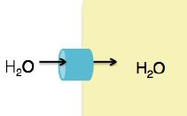
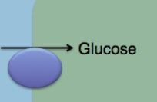
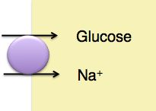
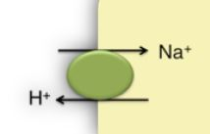
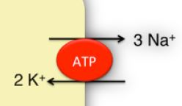
Review of Transport Mechanisms
Channels: Passive diffusion through a protein pore in membrane (ex: aquaporin)
Transporters: Carries molecule across membrane
Uniporters: Move a single molecule across membrane (ex: glucose uniporter)
Symporters: Moves two molecules in the same direction across membrane. At least one molecule must move down its concentration gradient (ex: Na+/glucose symporter)
Antiporters: Moves two molecules in opposite directions across membrane. At least one molecule must move down its concentration gradient (ex: Na⁺/H⁺ antiporter)
Primary Active Transporters: Require ATP to move molecules against their concentration gradients (ex: Na⁺/K⁺ ATPase)

Slide 44
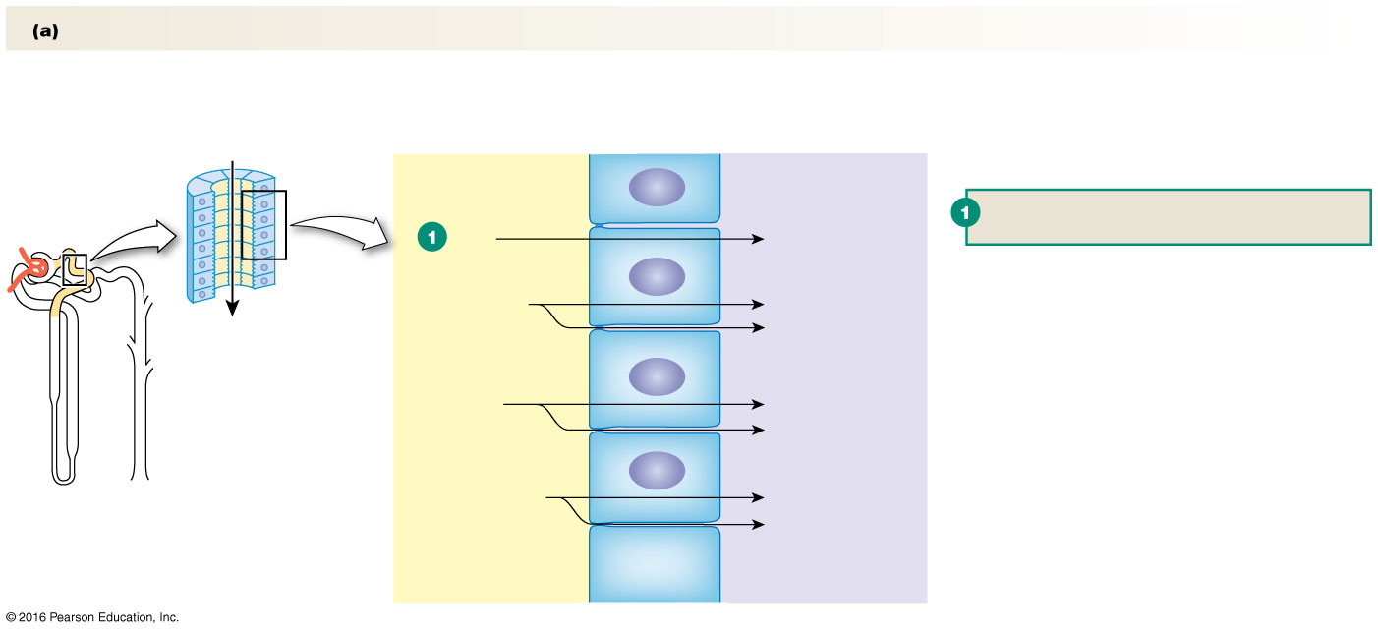
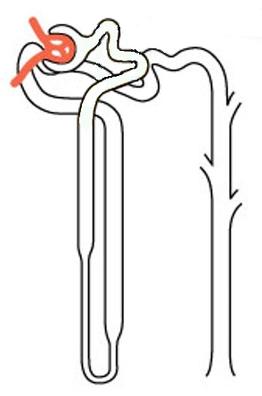
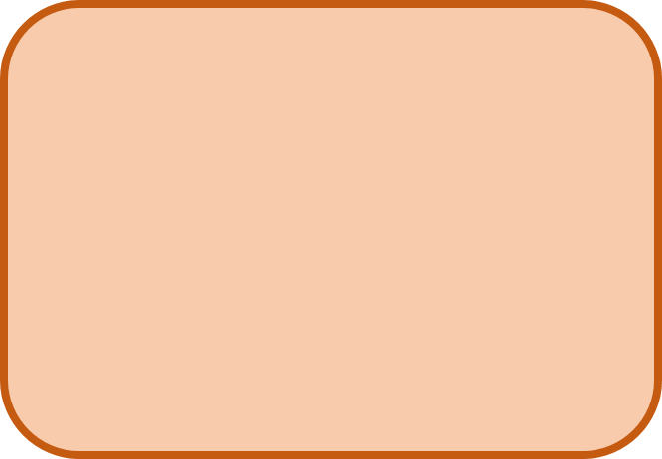
Proximal Tubule
Overall Goal:
REABSORPTION
Lumen of Proximal Tubule
Tight
Junctions
Tight
Junctions
Tight
Junctions
Luminal Membrane
Tubule (Epithelial) Cell
Basolateral Membrane
Interstitial Space
Blood vessel near proximal tubule

Slide 45
Sodium Potassium Pump
K⁺
ATP
Na/K ATPase: Maintains concentration gradients needed to drive transport of other molecules
Na⁺

Slide 46
Reabsorbing Amino Acids
Na⁺/Amino Acid Symporter: Uses Na⁺ gradient to carry an amino acid across luminal membrane against its concentration gradient
Na⁺
Amino
Acid
K⁺
ATP
Amino Acid Uniporter: Carries amino acid across basolateral membrane down its concentration gradient
Na⁺
Amino
Acid

Slide 47
Reabsorbing Glucose (100%)
Na⁺/Glucose Symporter: Uses Na⁺ gradient to carry glucose across luminal membrane against its concentration gradient
Na⁺
Amino
Acid
Na⁺
Glucose
K⁺
ATP
Glucose Uniporter: Carries glucose across basolateral membrane down its concentration gradient
Na⁺
Amino
Acid
Glucose

Slide 48
Reabsorbing Water
Aquaporin 1 (AQ1): Water Channel
Na⁺
Amino
Acid
Na⁺
Glucose
H₂O
K⁺
ATP
Amino
Acid
H₂O
Aquaporin 1 (AQ1): Water Channel
Na⁺
Glucose

Slide 49
Reabsorbing Ions and More Water
Paracellular Transport
Na⁺
Amino
Acid
Na⁺
Glucose
H₂O
K⁺
ATP
Na⁺
Amino
Acid
Glucose
H₂O
H₂O, Cl⁻, K⁺

Slide 50
Regulating pH of filtrate/urine
Na/H+Antiporter/Exchanger:
Uses Na gradient to carry H+
across luminal membrane into filtrate
H⁺
Na⁺
Amino
Acid
Na⁺
Glucose
H₂O
Na⁺
K⁺
ATP
Na⁺
Amino
Acid
Glucose
H₂O
H₂O, Cl⁻, K⁺

Slide 51
Which are hormonally regulated?
Angiotensin II
H⁺
Na⁺
Amino
Acid
Na⁺
Glucose
H₂O
Na⁺
K⁺
ATP
Na⁺
Amino
Acid
Glucose
H₂O
H₂O, Cl⁻, K⁺

Slide 52
Descending LOH
Overall Goal:
REABSORPTION
Lumen of Descending LOH
Tight
Junctions
Tight
Junctions
Tight
Junctions
Luminal Membrane
Tubule (Epithelial) Cell
Basolateral Membrane
Interstitial Space
Blood vessel near Descending LOH

Slide 53
Descending LOH
Overall Goal:
REABSORPTION
Aquaporin 1 (AQ1): Water Channel
H₂O
H₂O
H₂O
Aquaporin 1 (AQ1): Water Channel
H₂O
H₂O
H₂O
Other Key Points:
No Ion Reabsorption
No Paracellular Transport
No Hormonal Regulation

Slide 54
Ascending LOH
Overall Goal:
REABSORPTION
Lumen of Ascending LOH
Tight
Junctions
Tight
Junctions
Tight
Junctions
Luminal Membrane
Tubule (Epithelial) Cell
Basolateral Membrane
Interstitial Space
Blood vessel near Ascending LOH

Slide 55
Ascending LOH
Overall Goal:
REABSORPTION
Paracellular Transport
Na⁺
Na⁺
K⁺
2Cl⁻
K⁺
ATP
Na⁺
K⁺
Cl⁻
Na⁺
Other Key Points:
No Water Reabsorption
No Hormonal Regulation

Slide 56
Distal Convoluted Tubule
Overall Goal:
REABSORPTION
Lumen of Convoluted Tubule
Tight
Junctions
Tight
Junctions
Tight
Junctions
Luminal Membrane
Tubule (Epithelial) Cell
Basolateral Membrane
Interstitial Space
Blood vessel near Convoluted tubule

Slide 57
Distal Convoluted Tubule
Overall Goal:
REABSORPTION
Parathyroid
Hormone
Na⁺
Na⁺
K⁺
2Cl⁻
Ca²⁺
K⁺
Na⁺
ATP
Na⁺
K⁺
Cl⁻
Ca²⁺
Other Key Points:
No Water Reabsorption
No Paracellular Transport

Slide 58
Collecting Duct
Overall Goal:
Fine Tuning of H₂O Na⁺ Reabsorption
Lumen of Collecting Duct
Tight
Junctions
Tight
Junctions
Tight
Junctions
Luminal Membrane
Tubule (Epithelial) Cell
Basolateral Membrane
Interstitial Space
Blood vessel near Collecting Duct

Slide 59
Collecting Duct
Aldosterone
Overall Goal:
Fine Tuning of H₂O Na⁺ Reabsorption
ADH
Aquaporin 2 (AQ2)
Na⁺
K⁺
H₂O
K⁺
ATP
Aquaporin 3 and 4 (AQ3 and AQ4)
Na⁺
H₂O

Slide 60
Summary of Transport
 | Proximal Tubule | Descending Limb | Ascending Limb | Distal Tubule | Collecting Duct
Goal | Reabsorption of everything | Water reabsorption | Ion reabsorption | Ion reabsorption | Fine tuning (water and Na)
Water | Yes | Yes | No | No | Yes
Ions | Yes (Na⁺, Cl⁻, K⁺) | Minimal (Na⁺) | Yes (Na⁺, Cl⁻, K⁺) | Yes (Na⁺, Cl⁻, K⁺, Ca²⁺) | Yes (Na⁺)
Paracellular Transport | Yes | No | Yes | No | No
Hormone Regulation | Angiotensin II | - | - | PTH | Aldosterone ADH

Slide 61
Next Tutorial (Jan 28th)
More Renal physiology!

Slide 62
What Questions Do You Have?
You can ask in the Owl forums as well!
Also anonymously ask questions in the online dropbox!!

